Slide 1


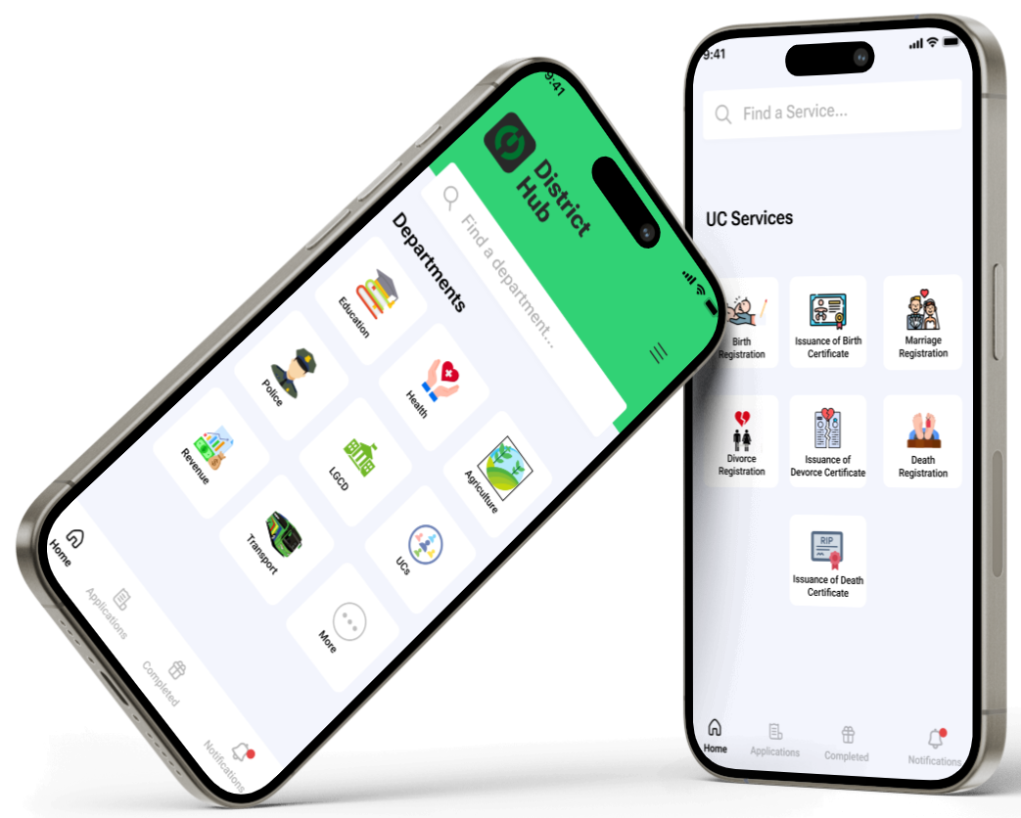




Digitalization of Model Union Councils
Digitalizing Union Councils through Mobile & Web Application under Monitoring the District Administration.

Slide 2
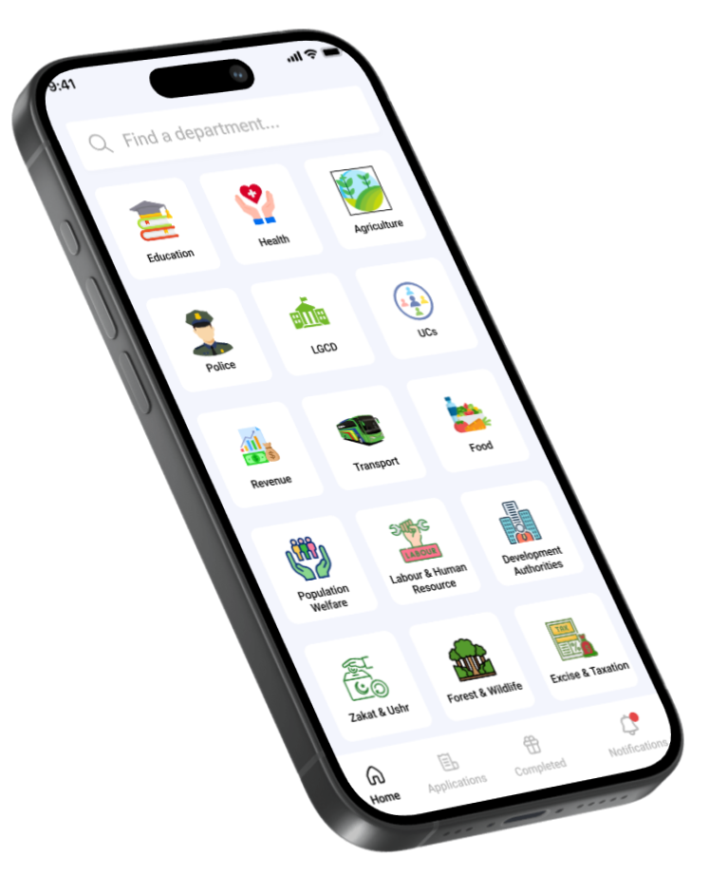
All the Services under Supervision of DC Office at Real-time
A Web and Mobile Based System which provides all the Model Union Council Services
at fingertip under the under Supervision of
DC Office at Real-time.
It provides all the services quick and in easy way.
Also with the Monitoring of Department Head and District Officer

Slide 3
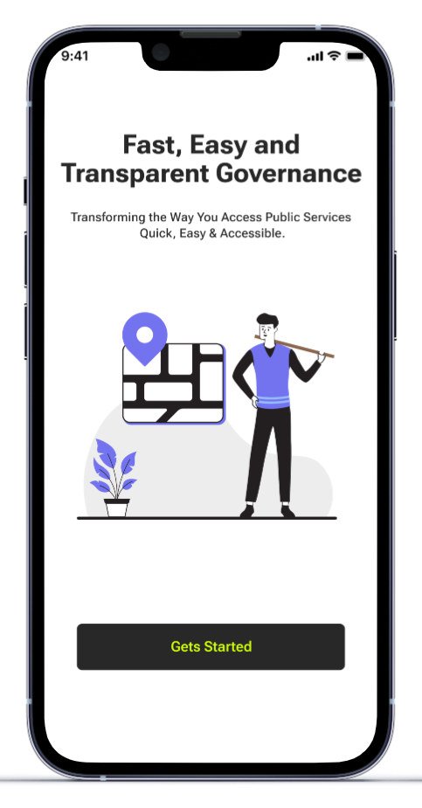
Problem Statement
Delays in service delivery due to Un-Supervision
Lack of transparncy & Monitoring
Problems for citizens to get Services in rural areas.
Inefficient Manual processes for Keeping Records of Services

Slide 4
System Architecture
Mobile Application: For citizens to access services.
Department Head Panel: For department-wise monitoring.
District Admin Dashboard: For centralized oversight.
User Request: User submits a service request via the app or web.
Admin Review: Request is sent to the relevant department admin as well District Officer.
Assignment: Admin assigns the request to an employee.
Employee Review: Employee reviews, validates data, and documents. User pays at the office to employee.
Service Delivery: Service is processed and delivered digitally or physically.

Slide 5
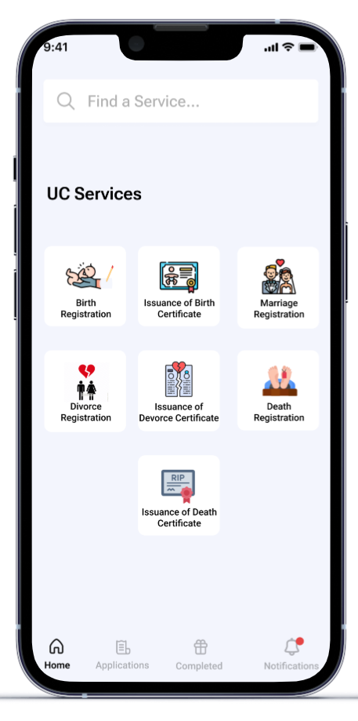
Services Covered
All the Service of each department is covered
Like For UC Services.
Birth & Death Registration
Birth & Death Certificates
Marriage & Divorce Certificates

Slide 6

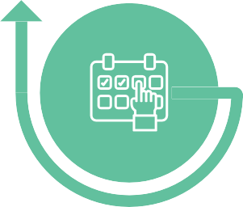

Key Features of the Application
Centralized Monitoring
Track services across all departments and Union Councils.
Department Admin Admins for each department to oversee their services.
District-Level Admin: Overarching control for monitoring all activities.
Online Service Requests
Apply for birth certificates, marriage certificates, etc.
Real-time Updates: Notifications for service status and updates.

Slide 7
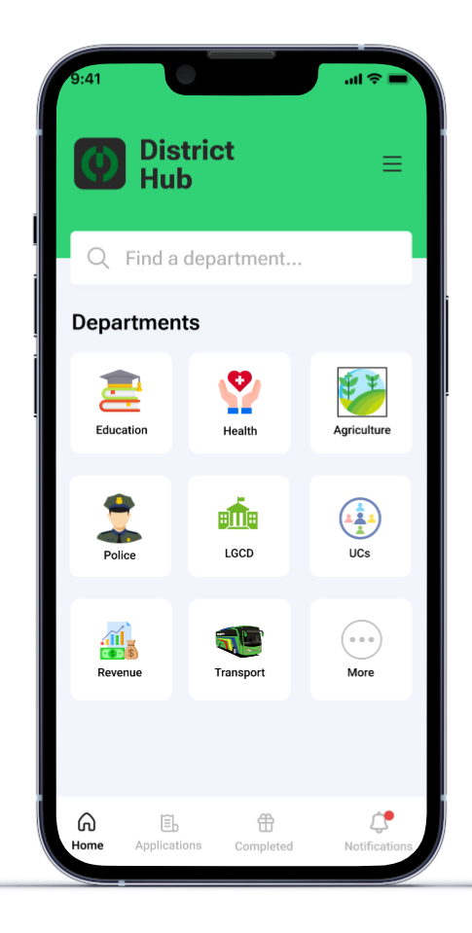
Departments Covered
Health Department
Livestock Department
Education Department
Agriculture Department
Local Government Department

Slide 8
Services Covered
All the Service of each department is covered
Like For UC Services.
Birth & Death Registration
Birth & Death Certificates
Marriage & Divorce Certificates

Slide 9
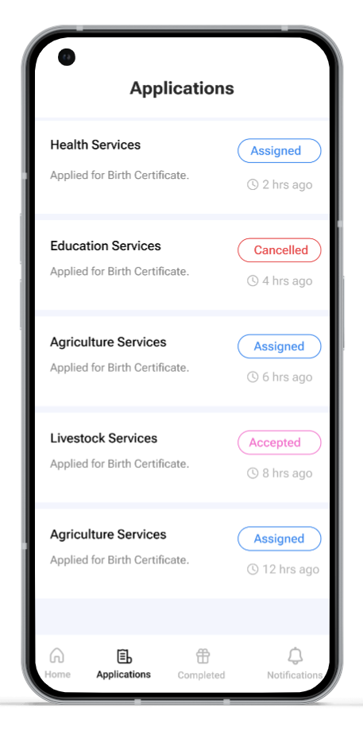
Check Application Status
Citizen can also check his/her application status either
In Progress
Completed
Declined

Slide 10
Notifications
Pending Applications
Application Management
Service Delivery
Employee App Features
Notifications:
Alerts for new service requests.
Pending Applications:
Highlighted in red for immediate attention.
Application Management: Easy access to assigned requests.
Service Delivery: Options to mark services as completed.

Slide 11
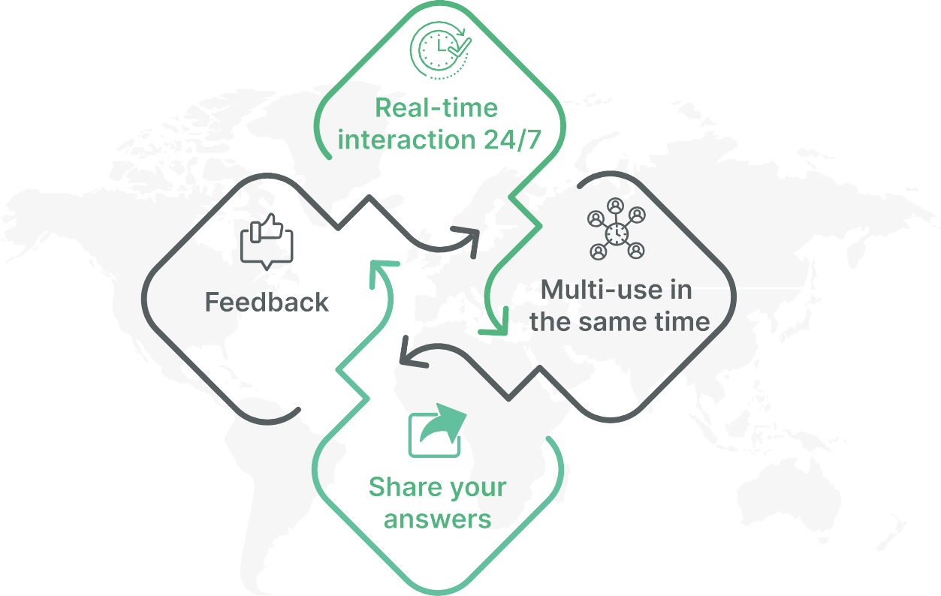
24/7 Availability & Accessibility of Services

